Slide 1
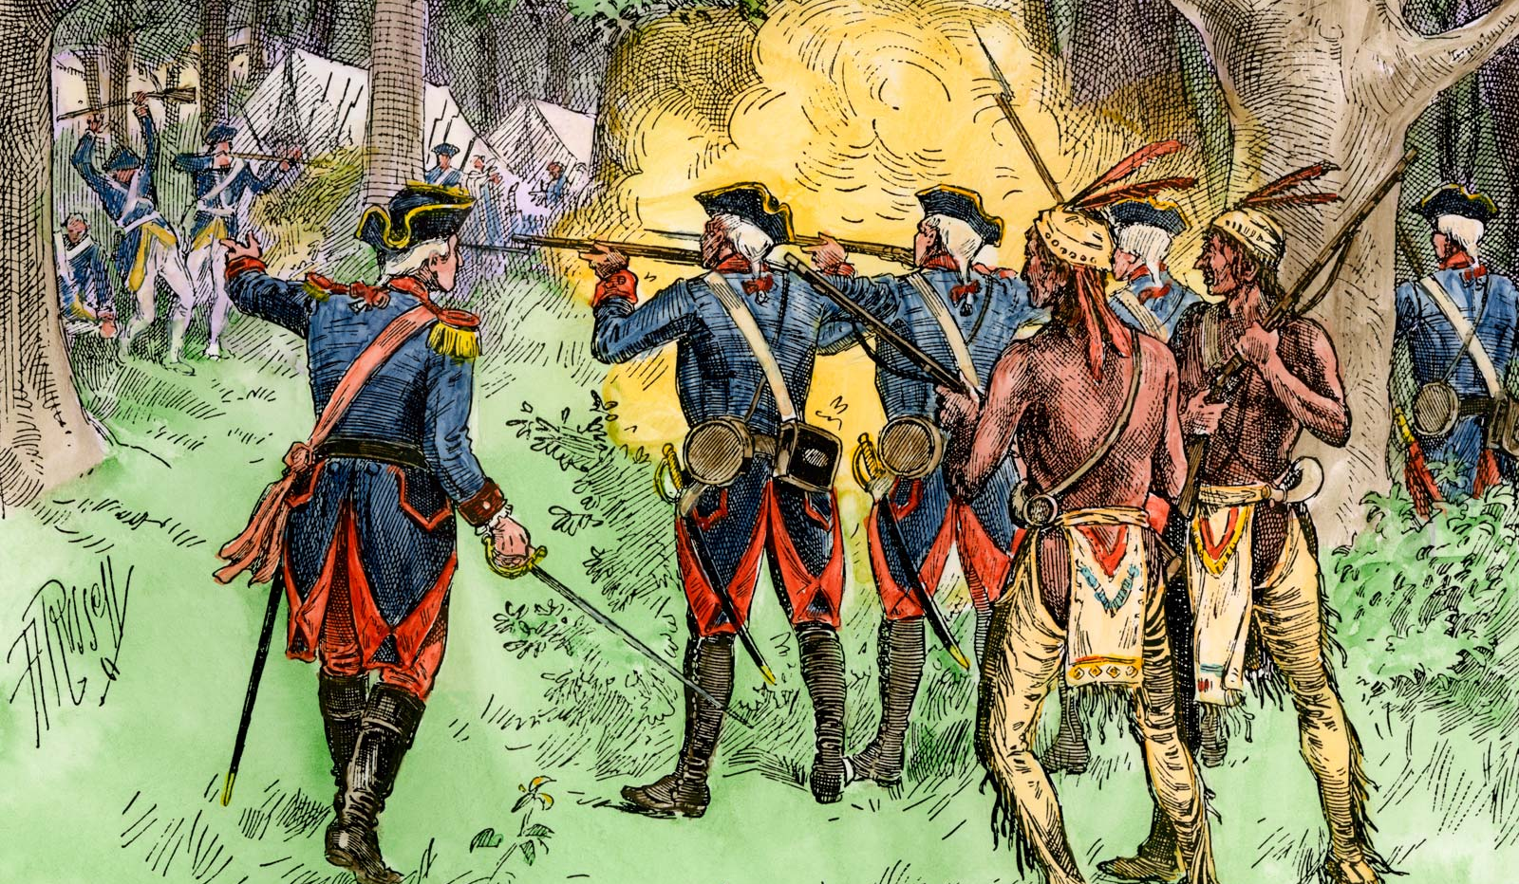
Unit 1B: The Road to Independence
Topic: Join or Die- The French & Indian War
Aim Question: How did the American colonies unite during the lead-up to the French and Indian War?
Thursday, September 26, 2019

Slide 2
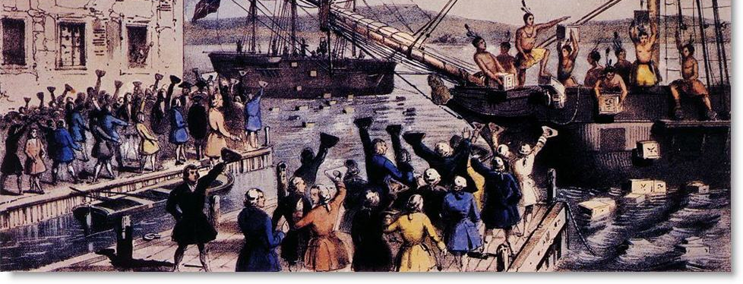
Unit 1B: Unifying Themes
Power, authority, & governance
Civic ideals & practices
Time, Continuity, & Change
Expansion of Economic Systems

Slide 3
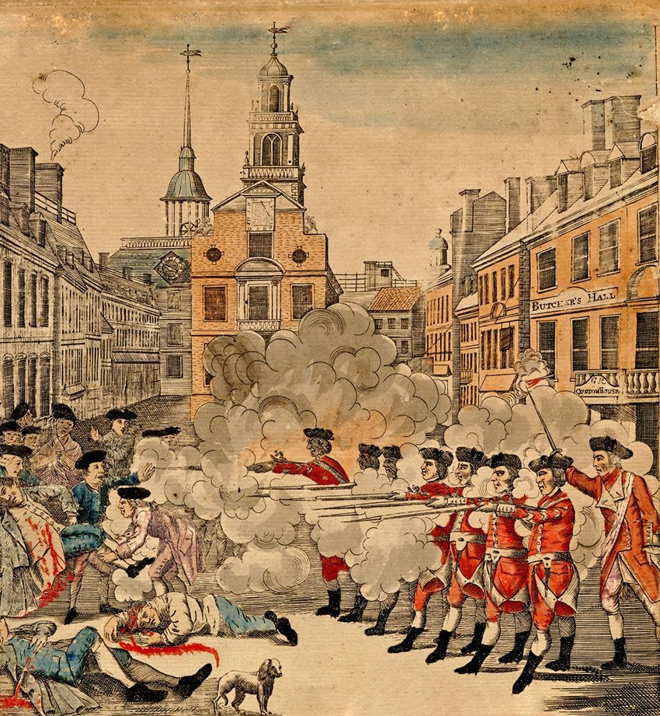
Unit 1B: Essential Questions
What are the roots of American democracy?
How did America evolve from a colony to an independent nation?
How did colonial experiences prepare the colonists for revolution?

Slide 4
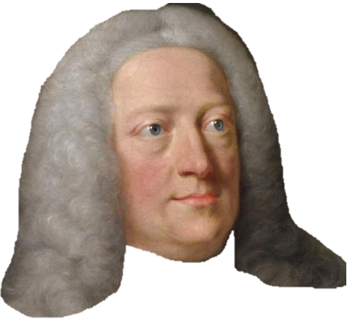
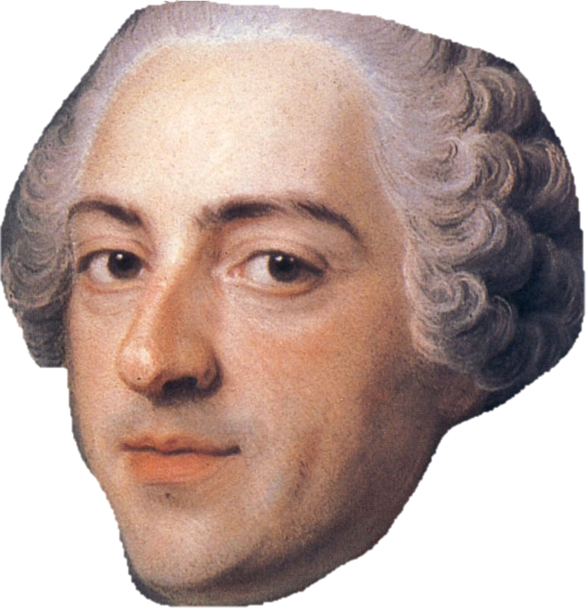
1st: What was the French & Indian War?
FRANCE
ENGLAND

Slide 5
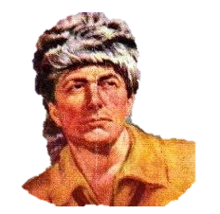
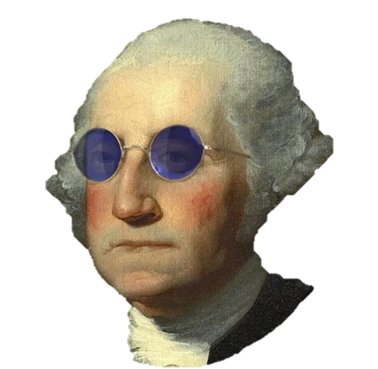
French & Indian War (AKA: 7 Years War)
1756-1763 French & Native American allies v. British & Native American allies
France expanding territory in America (Ohio River Valley) → conflict with British over land claims
Early victories for France = brutal defeats for Britain
Famous survivors:
Daniel Boone
George Washington
Guy who didn’t make it out:
General Edward Braddock
“We shall better know how to deal with them another time”
-reported last words

Slide 6
French & Indian War: Britain Fights Back
War started in the colonies but soon reached Europe and Asia (mainland + other British/French colonies abroad)
Sensing an all-out world war and fearing the fate of the British Empire, Prime Minister William Pitt began taking out loans and raising taxes to pay for military spending
Trick worked → British returned to battle better prepared and equipped
After a series of key battles throughout North America (modern-day U.S. and Canada), Britain defeated the French and their allies in 1763
*Treaty of Paris 1763: ended the war officially; Britain gained present-day Canada and surrendered its claim to the land east of the Mississippi River (ONLY EXCEPTION: NEW ORLEANS, LOUISIANA); France’s ally Spain gave Florida to Britain, in exchange for Cuba (which Britain had captured during the war)

Slide 7
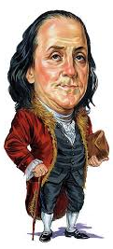
Benjamin Franklin & The Albany Plan of Union
June 1754: fighting had already begun between British & French in the colonies even though war wasn’t officially declared yet
Benjamin Franklin and other delegates from 7 colonies met in Albany, New York to discuss unifying and strengthening themselves against outside threats
Inspired by the Iroquois League, Franklin proposed the Albany Plan of Union: this called for a grand council of delegates from each colony, led by a President General who would be appointed by the British crown (King or Queen)
Delegates at the meeting approved the idea, but colonial legislatures rejected it- sorry Ben Franks
SIGNIFICANCE: Though it was rejected, the Albany Plan of Union later provided a model for the government of the United States after the colonies gained their independence.

Slide 8
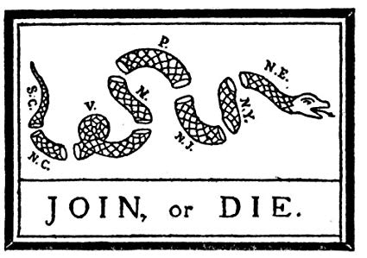
Join or Die
1754: Ben Franklin wrote an article in the Pennsylvania Gazette informing colonists of conflicts between the French/their allies and the colonists
He wrote about the taking of Fort Necessity, a stronghold built and defended by colonists, including George Washington; the fort was easily taken by the French
He also wrote about atrocities committed by the French & their allies, including stealing colonists’ property and murdering them

Slide 9
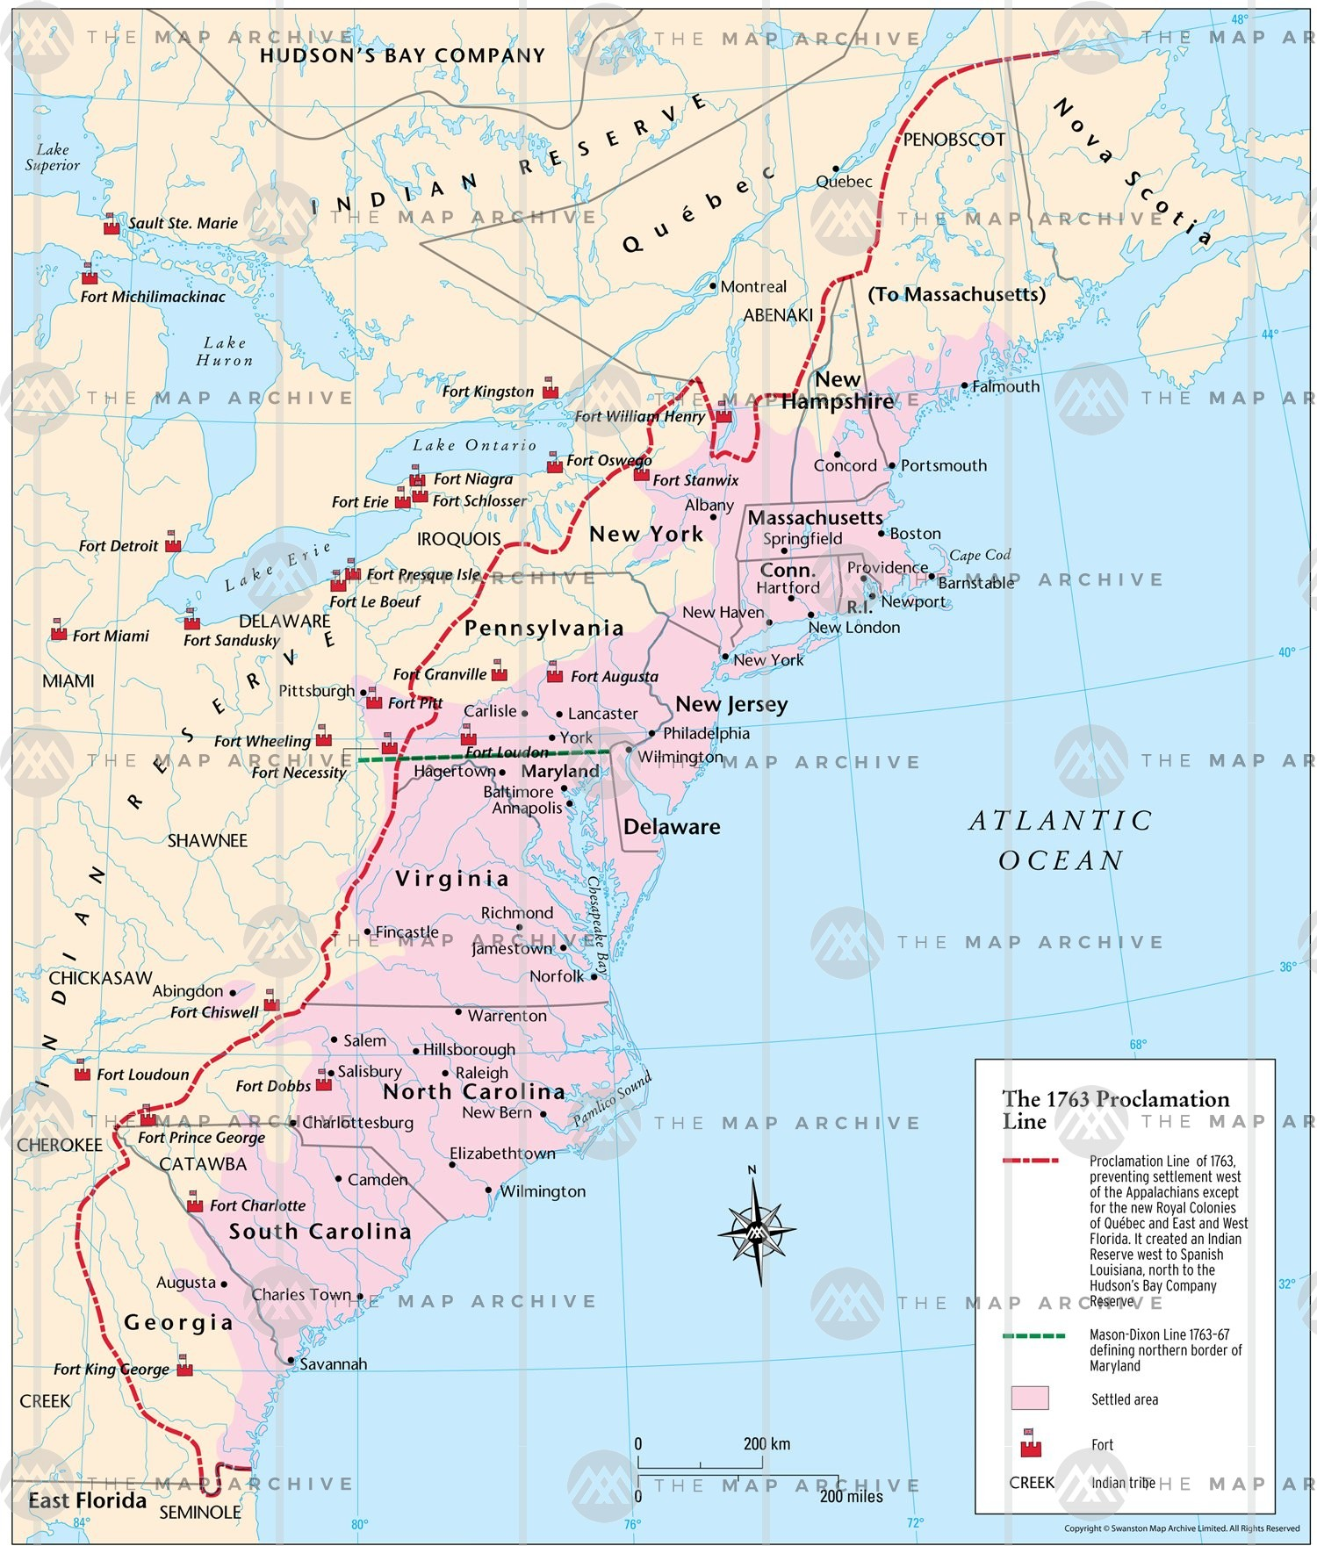
U1B: The Road to Independence
Topic: The Aftermath of the French & Indian War
Aim: How did Britain become the colonists’ enemy after the French & Indian War?
Friday, September 27, 2019

Slide 10
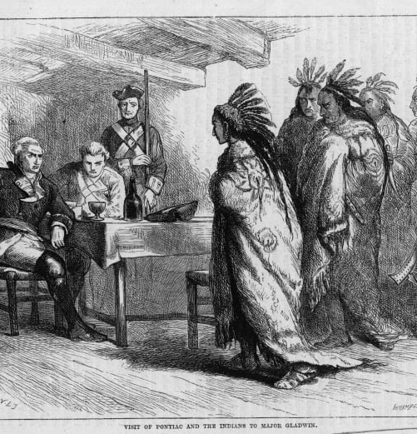
Aftermath of the French & Indian War
Britain wins the war in 1763- woohoo
Britain also gains a lot of land from the victory- woohoo
But there are consequences for the American colonists…
Proclamation Line of 1763
New taxes

Slide 11
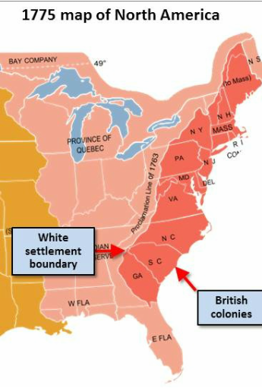
Proclamation Line of 1763
The British wanted to avoid future conflicts with the Native Americans
Drew an imaginary boundary along the Appalachian Mountains, separating Native American territory from the 13 colonies.
The colonists were forbidden from settling west of this line and taking Native American land.
Colonists already living west of this line were ordered to abandon their homes and move back into the 13 colonies.

